Slide 1
SU Bookstore Procurement Analysis system
Sandya Madhavan
Peniel Aponte
Dinesh Reddy

Slide 2
Overview
1.Introduction
2.Plan phase
a.Requirement gathering
b.Use-case modelling
c.Data flow modelling
3.Design phase
a.ERD modelling
b.User-interface
c.System Architecture
4.Implementation phase
a.Development & Testing
b.Training
5.Feasibility analysis

Slide 3
Background
Bookstore Provide students with the tools for academic achievement and success but at the cost of monetary loss
Concerned with the amount of books being ordered in comparison to amount being bought
Business Case
To empower the bookstore by providing them with a system that can aid their decision making process in finalizing the no.of books that should be bought.

Slide 4
Plan Phase

Slide 5
Requirement Collection
Technique | Description of Activity
Questionnaire | Created a list of questions relevant to the project.The questionnaire consisted of both open and closed ended questions
Interview | Met the director of SU bookstore in person and obtained answers for the questionnaire prepared in the previous step.Key issues faced by the Bookstore regarding book sales were discussed and high level requirements were noted

Slide 6
The solution
1.Find whether a book is available online in a free pdf and rental version
2.Find the cost comparison of the book in various websites
3.Generate a sales history of the book
-Display the results to the bookstore admin while finalizing a book request

Slide 7
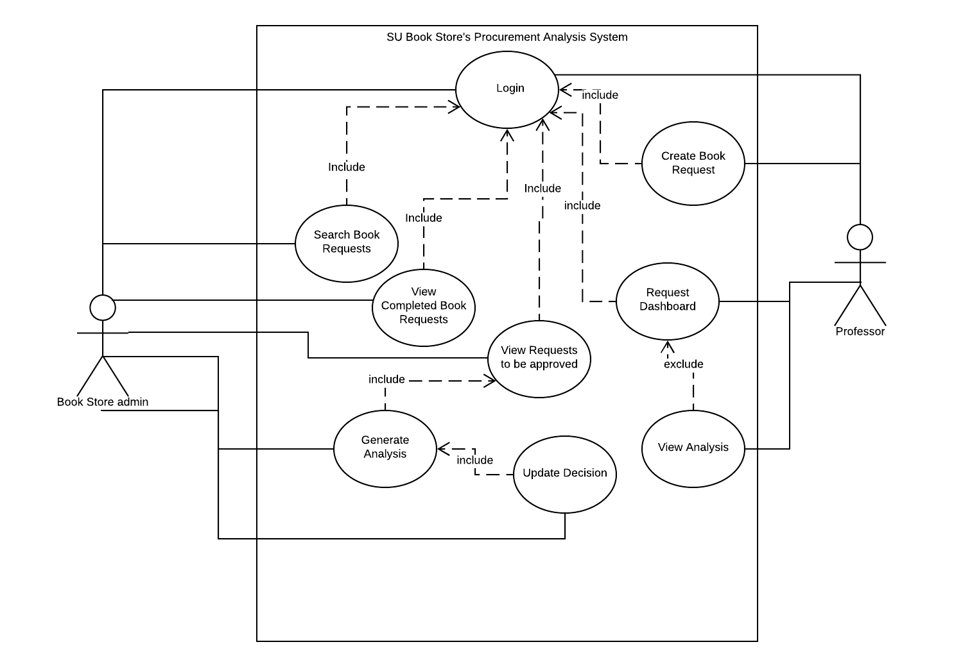
Use Case Diagram

Slide 8
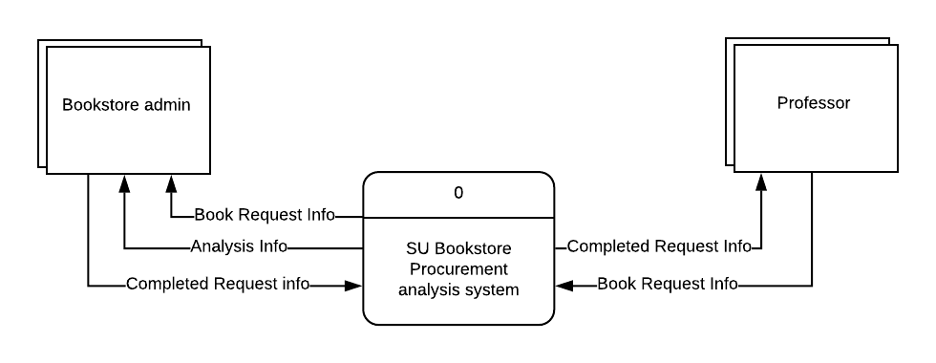
Context 0 diagram

Slide 9
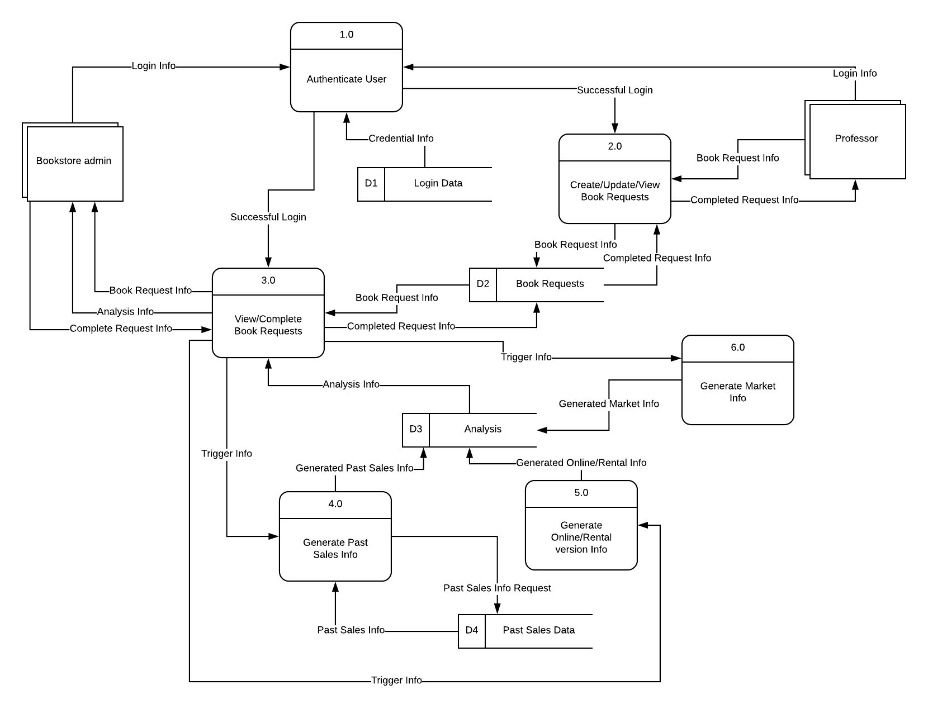
Level 1 Diagram

Slide 10
Design Phase

Slide 11
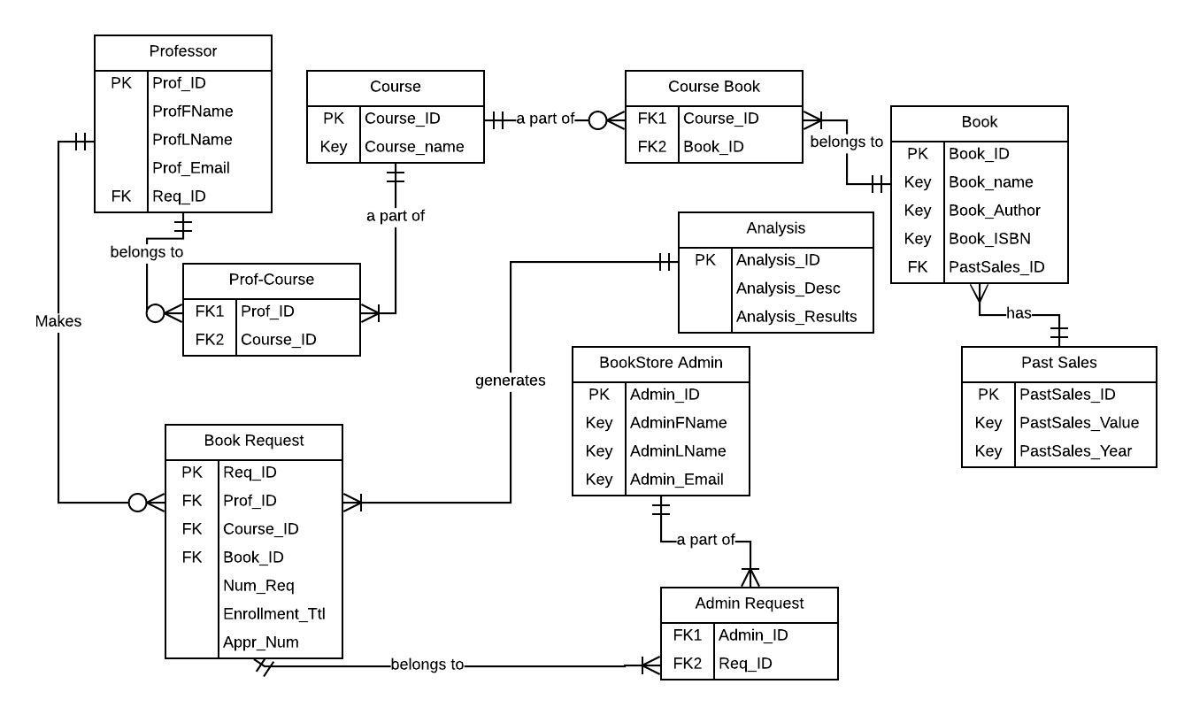
ER-Diagram

Slide 12
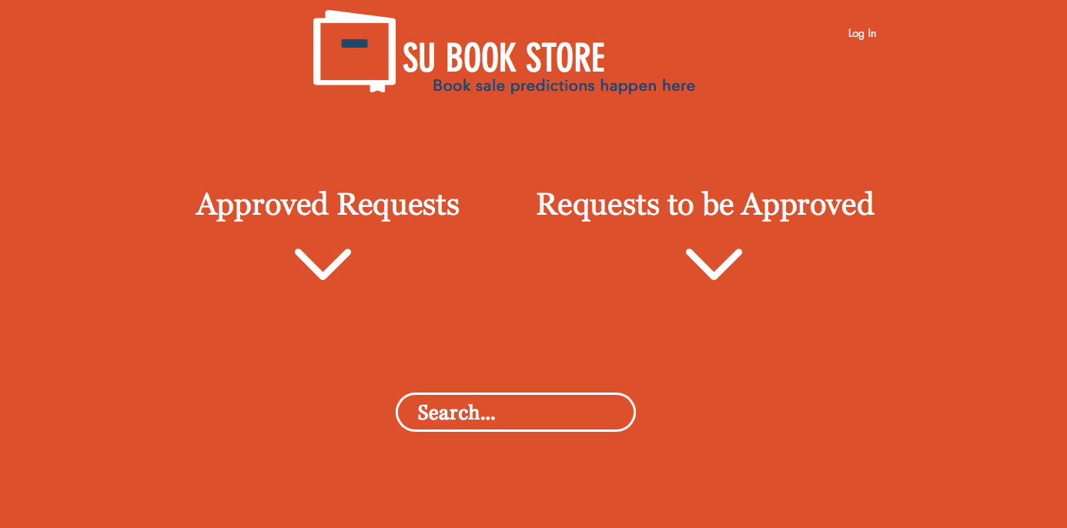
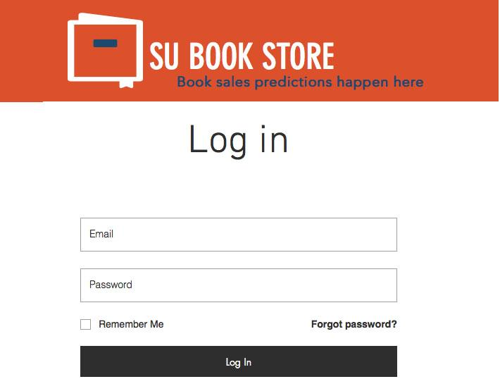
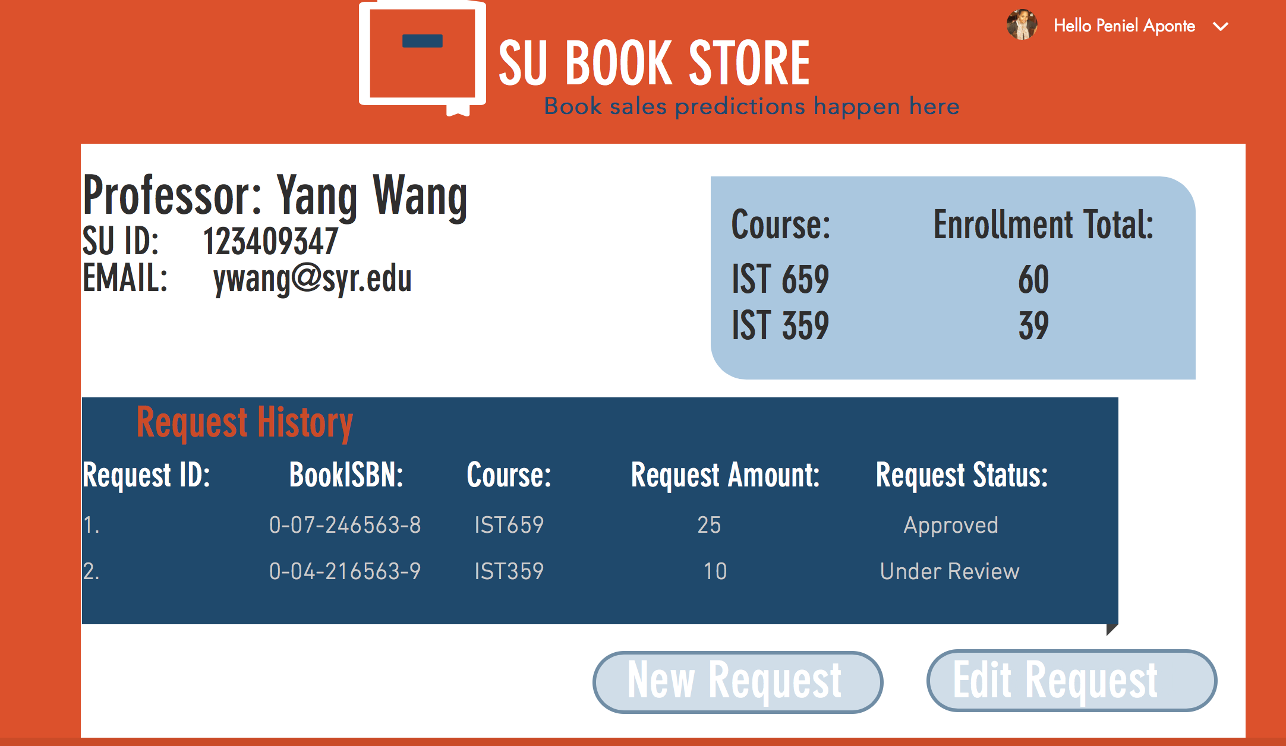
User Interface Design

Slide 13
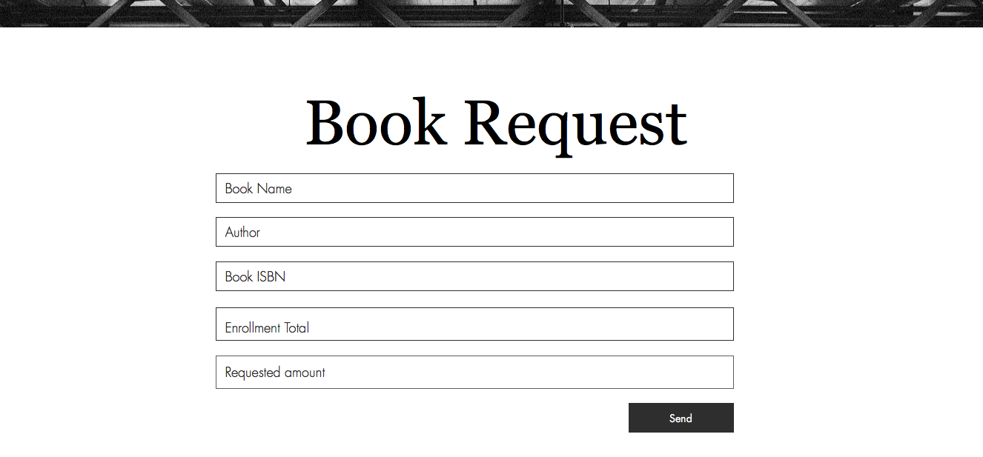

Slide 14
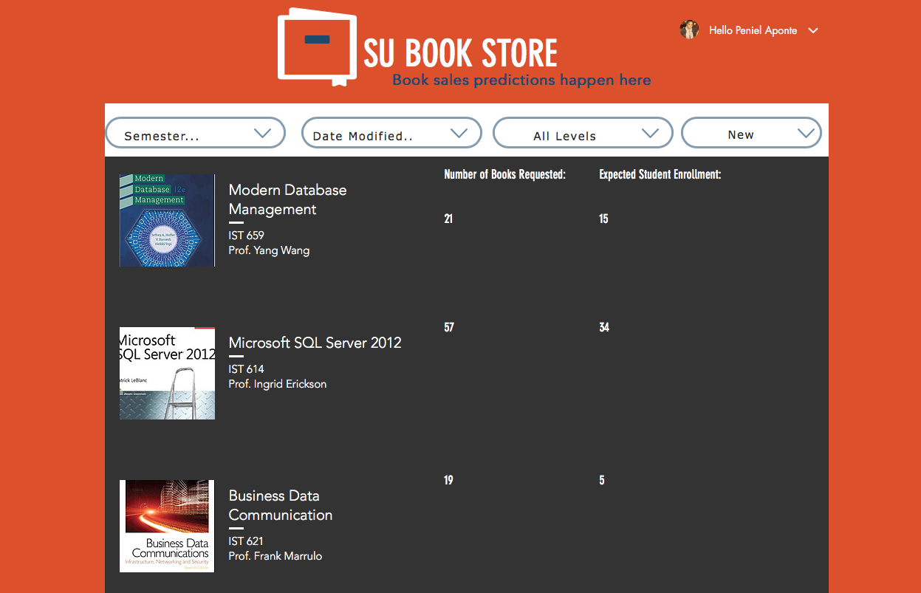
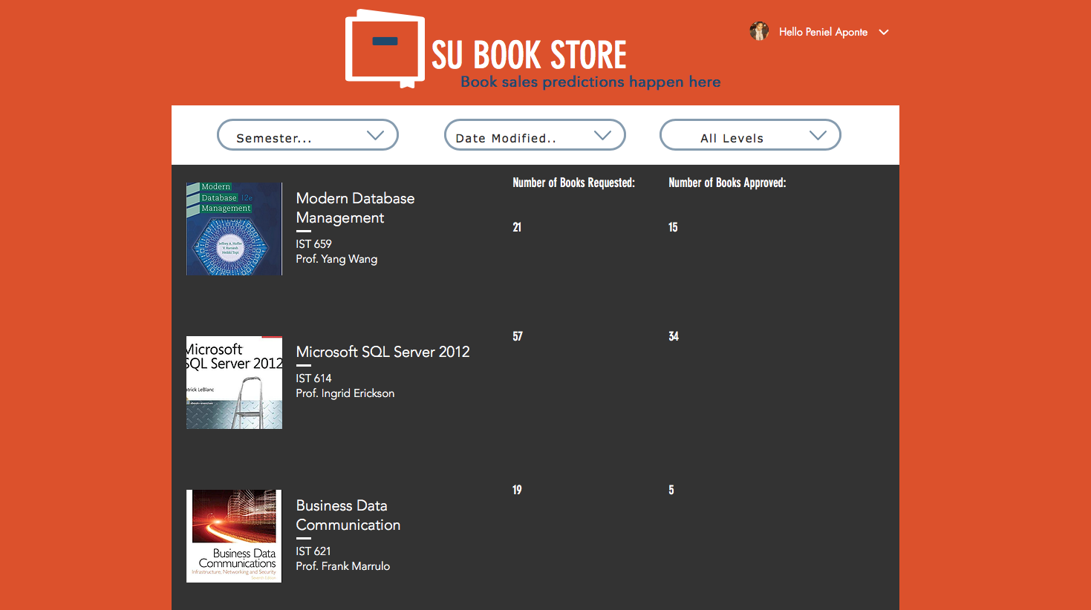
Request to be approved
Completed Request

Slide 15
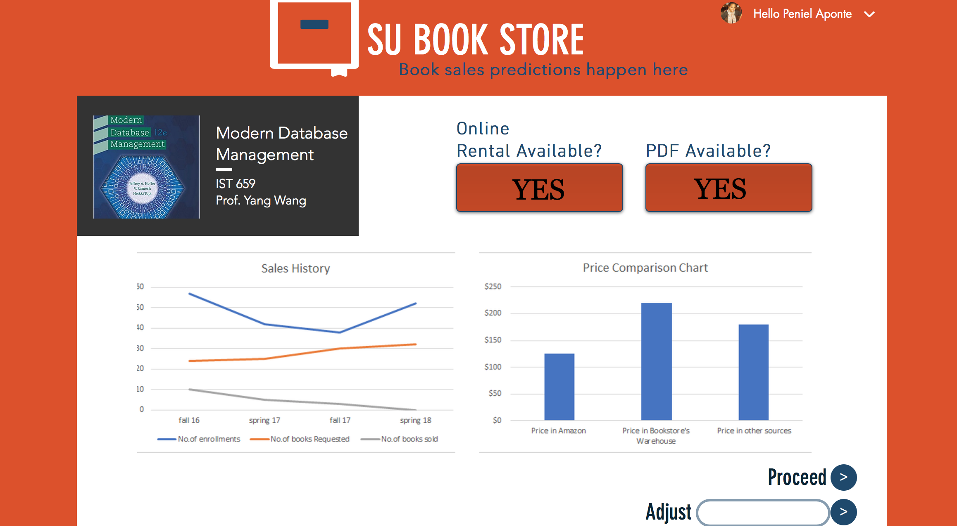
Analysis

Slide 16
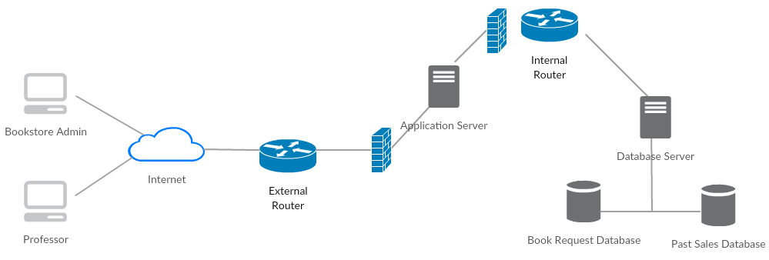
System Architecture

Slide 17
Implementation Phase

Slide 18
● Agile approach
● Components included:
○Database system
○User interface (front-end)
○Back-end server support
○Framework to contact API
●Estimated time: 2 months
Development and Testing
Unit Testing:
Code is tested by the developers to identify any errors
Integration testing:
The deployed code will be integrated and tested by testing team end to end to identify defects
Alpha and Beta Testing:
Once testing team gives a sign off, the application is tested by the end users

Slide 19

Training
Ninety hours of training
Budget allocated for training
Schedule included for training
Orientation Provided for new hires

Slide 20
Feasibility analysis

Slide 21
Operational Feasibility: ●Training Users ●Potential risks and conflicts ●legal and ethical considerations | Economic Feasibility: ●$120,000 budget ●$82,520 one time investment (people, training, consultation) ●$30,000 System Annual Profit ●ROI in less than 1 year | Technical Feasibility: ●PM Supervision ●Data analytics adoption ●Full BI Capabilities/ Interactive Dashboard ●UI/UX Designer needed: > Data Analyst and Visualization Specialist | Schedule Feasibility: ●Project nature Consideration ●1st of Feb, 2019(3 months) ●critical paths and Gantt charts are used ●Training considered ●on time within the budget
Notes:
Don’t talk about data analytics adoption

Slide 22
Project Budget
Develop web platform based on SDLC life cycle using Agile methodology
Time: 2 months
Direct cutover system
Criteria of Success
1. User satisfaction 2. Time, cost and scope 3. System testing
Business Benefits 1. Decrease in wastage of books 2. Opportunity for innovation 3. Increase efficiency

Slide 23
Thank You !!!

